Slide 1

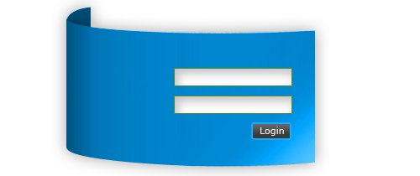
Directives and Forms
Creating Directives. Handling Forms.
SoftUni Team
Technical Trainers
Software University
https://softuni.bg

Slide 2
Table of Contents
Directives
Attribute Directives
Structural Directives
Building an Attribute Directive
Handling Forms
Template-Driven Forms
Reactive Forms
2

Slide 3
Have a Question?
sli.do #js-web

Slide 4

Directives
Manipulating the DOM in Angular

Slide 5
Directives Overview
There are three types of directives in Angular
Components – directives with template
Attribute directives - change the appearance or behavior of an element, component or another directive (ngStyle and ngClass)
Structural directives - change the DOM layout by adding and removing DOM elements (*ngIf and *ngFor)
5

Slide 6
Directives Comparison
Attribute Directives
Look like HTML attributes
Only affect/change the element they are added to
Example - ngStyle, ngClass
Structural Directives
Have a leading *
Affect a whole area in the DOM
Examples - *ngIf, *ngFor
6

Slide 7
Build a Simple Attribute Directive
An attribute directive minimally requires building a controller class annotated with @Directive
Surround the selector with square brackets
import { Directive } from '@angular/core'
@Directive({
selector: '[appHighlight]'
})
export class HighlightDirective {
constructor() { }
}
Import the directive in declarations array

Slide 8
Attach Styles to Referenced Elements
Now inject the referenced element and change it's background style
export class HighlightDirective implements OnInit {
constructor(private el : ElementRef) {}
ngOnInit() {
this.el.nativeElement.style.backgroundColor = 'yellow'; }
}

Slide 9
Warning - Use Renderer2
It's not a good practice to directly access DOM elements via ElementRef
Angular is not limited to run only on the browser (could run with service workers)
Services Worker – environment where the DOM is inaccessible
Use Renderer2 to manipulate DOM elements
import { Renderer2 } from '@angular/core'
9

Slide 10
Renderer2 Usage
Inject the renderer and access it's methods to change the DOM
constructor( private renderer: Renderer2) { }
ngOnInit() {
this.renderer.setStyle(
this.el.nativeElement,
'background-color',
'red'
);
}
10

Slide 11
Respond to Events
A directive can be more dynamic and detect user events
Attach host listeners to handle different DOM events
import { HostListener } from '@angular/core'
@HostListener('mouseenter') onMouseLeave(e) {
this.highlight('yellow');
}
@HostListener('mouseleave') onMouseLeave(e) {
this.highlight('blue');
}

Slide 12
Using HostBinding
Bind to DOM properties without Renderer
import { HostBinding } from '@angular/core'
export class BasicHighlightDirective {
@HostBinding('style.backgroundColor')
backgroundColor: string;
highlight(color: string) {
this.backgroundColor = color;
}
}

Slide 13

Handling Forms
Template-Driven Forms

Slide 14

Forms Overview
Forms are the mainstay of business applications
We use Forms to
Register/Log in
Submit a help request
Place an order
Book a flight and more
Guide the user efficiently and effectively when creating forms
14

Slide 15
Template-Driven Forms
Build a Form by writing templates using the Angular template syntax
Track state changes (validity of form controls)
Provide visual feedback using special CSS classes
Display validation errors when needed
Use reference variables to share information
15

Slide 16
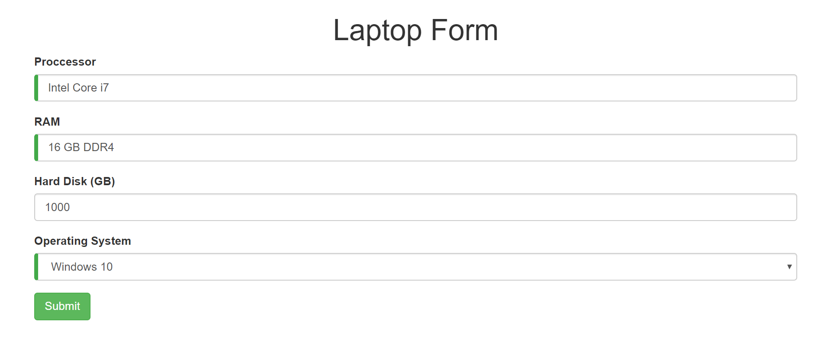
Problem: Create a Template-Driven Form
Create a Template-Driven Form looking like this

Slide 17
Import Bootstrap
Bootstrap is the most popular open-source front-end framework for designing web sites and web apps
Install via npm and import it inside angular.json
Create containers, form-groups, form-controls, style buttons and errors
"styles": [
"node_modules/bootstrap/dist/css/bootstrap.min.css",
"src/styles.css"
]

Slide 18
Introducing Forms Module
Angular is module based and to handle Forms (ngModel, ngSubmit, ngForm) we need Forms Module
Import the following in app.module.ts
import { FormsModule } from '@angular/forms';
@NgModule({
imports: [
BrowserModule,
FormsModule
]
})
export class AppModule { }

Slide 19
Create Form Component
An Angular form has two parts
An HTML-based template
Component class to handle data
@Component({…})
export class LaptopFormComponent {
operatingSystems: string[] = [
'Windows 10',
'Linux',
'Mac OS'
];
}

Slide 20
Initial HTML Template
<div class="container">
<h1>Laptop Form</h1>
<form>
<div class="form-group">
<label for="processor">Proccessor</label>
<input type="text" class="form-control" id="processor"
required>
</div>
<div class="form-group">
<label for="ram">RAM</label>
<input type="text" class="form-control" id="ram"
required>
</div>
<div class="form-group">
<label for="hardDisk">Hard Disk (GB)</label>
<input type="number" class="form-control" id="hardDisk">
</div>
</form>
</div>
20

Slide 21
Initial HTML Template (2)
<div class="form-group">
<label for="os">Operating System</label>
<select class="form-control"
id="os"
required>
<option *ngFor="let os of operatingSystems" [value]="os">{{os}}</option>
</select>
</div>
<button type="submit" class="btn btn-success">Submit</button>
21

Slide 22
The NgModel Directive
We need to display, listen and extract data at the same time
This is done by using the ngModel directive
The following directive will not work without a name attribute
<input type="text"
class="form-control" id="processor"
ngModel />
<input name="processor"/>

Slide 23
The NgForm Directive
Declare a template variable to the form
Angular automatically attaches an NgForm directive
The NgForm directive adds additional features
Monitors properties
Validates properties
It holds a valid property which is true only if all controls are valid
<form #f="ngForm">

Slide 24
Access the Local Reference
Use @ViewChild to access the local reference
@Component({…})
export class LaptopFormComponent implements AfterViewInit {
@ViewChild('f') form: NgForm
ngAfterViewInit() {
console.dir(this.form);
}
}

Slide 25
Submit a Form
To submit a form bind ngSubmit event property to form component's onSubmit method
The onSubmit method should send the control values directly to an API through a service of some sort
<form (ngSubmit)="onSubmit()" #f="ngForm">
onSubmit() {
const content = this.form.value;
// Send model to API
}

Slide 26
Tracking Form State
The NgForm Directive
Tracks if the user touched the control
Tracks if the user changed the control
Tracks if the control is valid
The directive doesn't just track state
It can update the control with special Angular CSS classes
Leverage those class names to change appearance
26

Slide 27
Track Control State
State | Class if true | Class if false
The control was visited | ng-touched | ng-untouched
The control's value was changed | ng-dirty | ng-pristine
The control is valid | ng-valid | ng-invalid

Slide 28
Add Custom CSS for Visual Feedback
You can mark required fields and invalid data at the same time with a colored bar on the left of the input box
styles.css
input.ng-valid {
border-left: 5px solid #42A948; /* green */
}
input.ng-invalid.ng-touched {
border-left: 5px solid #A94442; /* red */
}

Slide 29
Add Validation
Add HTML 5 attributes to input fields for validation
Angular tracks most attributes and changes the state depending on what the user enters
<input type="text" class="form-control"
id="processor"
required
minLength="5"
ngModel
name="processor">

Slide 30
List of Validators/Third-party Validators
Angular is shipped with the following validators
https://angular.io/api/forms/Validators
For template-driven forms you will need directives
https://angular.io/api?type=directive
There are multiple npm packages for custom validators
https://www.npmjs.com/package/ng5-validation

Slide 31
Outputting Error Messages
The user should know exactly what went wrong
Leverage the control's state to reveal a helpful message
Add a template reference variable in the input
<input type="text" class="form-control"
id="processor"
required
ngModel
name="processor"
#processor="ngModel">

Slide 32
Outputting Error Messages (2)
Create a div and display it only when the control state is invalid
Use the reference variable to check the state
Add a helpful message inside the div
<div *ngIf="processor.invalid && proccer.touched" alert alert-danger">
Processor is required!
</div>

Slide 33

Form Overall Validity
We can bind the form's overall validity using the reference variable declared in the <form> tag
Block the submit button in case a control has invalid state
<button type="submit" class="btn btn-success" [disabled]="f.invalid">
Submit
</button>

Slide 34
Two-way Data Binding
Instantly react to any changes using two-way data binding
<input type="text" class="form-control"
id="processor"
required
[(ngModel)]="laptop.processor"
name="processor"
#processor="ngModel">
constructor() {
this.laptop = new Laptop()
}

Slide 35
The NgModelGroup Directive
Group similar input fields using ngModelGroup
Useful for input fields that have the same validation
Password/Confirm password
<div
ngModelGroup="passData"
#passData="ngModelGroup">
<div *ngIf="passData.invalid && passData.touched">
Both passwords must be valid!
</div>

Slide 36
Setting and Patching Form Value
Use setValue() or patchValue() to change the form from inside the component or add default values
changeInput() { this.laptopForm.form.patchValue({
ram: '16 GB'
processor: 'Intel Core i7' });
}

Slide 37
Resetting the Form
After a form is submitted resetting is necessary to clear all input fields and reset the track state
onSubmit() {
const body = this.form.value;
// Send body to an API
this.form.reset(); }

Slide 38
Handling Forms
Reactive Forms

Slide 39
Reactive Forms Overview
There are some scenarios that can't be resolved using template-driven forms
Using Form Arrays
Dynamic Form Creation
39

Slide 40
Reactive Forms Module
In order to use reactive forms we need the Reactive Forms Module
Now we have access to all the needed directives
formGroup
formControl and formControlName
formGroupName
formArrayName
import { ReactiveFormsModule } from '@angular/forms'

Slide 41
The Component Class
The component class will create instances of FormGroup and FormControl that will bind later in the template
The core idea is to transfer most of the logic from the template inside the component class
import { FormGroup, FormControl } from '@angular/forms'
this.laptopForm = new FormGroup({
processor : new FormControl('Intel Core i7'),
ram : new FormControl('16 GB DDR4')
});

Slide 42
The Template
In the template we have to mark the main formGroup and after that add formControlName to each form control
<form (ngSubmit)="save()" [formGroup]="laptopForm">
<input type="text" class="form-control" id="processor"
required
formControlName="processor">
The name of the key instance

Slide 43
Accessing Form Model Properties
Two ways to access the properties of the form model
The idea is to shorten the template and transfer such logic in the component when using reactive forms
laptopForm.controls.processor.valid
laptopForm.get('processor').valid

Slide 44
Using Form Builder
Use FormBuilder service to avoid create instances of FormGroup and FormControl name
Inject it into the constructor
import { FormBuilder } from '@angular/forms';
constructor(private fb : FormBuilder) { }
this.laptopForm = this.fb.group({
processor : 'Intel Core i7',
ram : '16 GB DDR4'
});

Slide 45
Validation
In reactive forms we can add validation more dynamically based on user action
We can adjust rules at runtime
We can create custom validators
Custom validators excepting parameters
Cross-field validations and more

Slide 46
Setting Up Build-in Validation
Defining our FormGroup with a FormBuilder allows us to add an array of validations using the Validators class
this.laptopForm = this.fb.group({
processor : [
'Intel core i7', [
Validators.required,
Validators.minLength(10)
]
]
});

Slide 47
Adjust the Template
The formGroup directive has an errors property which can be used to show errors only when needed
<div *ngIf="(laptopForm.get('processor').touched
|| laptopForm.get('processor').dirty)
&& laptopForm.get('processor').errors" class="alert alert-danger">
<span *ngIf="laptopForm.get('processor').errors.required">
Processor is required!
</span>
<span *ngIf="laptopForm.get('processor').errors.minlength">
Processor should be at least 10 symbols long!
</span>
</div>

Slide 48

Watching and Reacting to Changes
Using Reactive Forms we have the ability to watch and react to changes on form groups and form controls
Whenever a value of an input changes we can subscribe to that event and handle the observable
this.laptopForm.get('os')
.valueChanges
.subscribe(console.log);

Slide 49
Reactive Transformations Example
Import throttleTIme from the following library
Attach the throttleTIme function to a form control's valueChanges event
import { throttleTime } 'rxjs/operators';
processorControl.valueChanges
.pipe(throttleTime(1500))
.subscribe(value => {
console.log(value);
});

Slide 50

Summary
There are three types of Directives
Components, Structural, Attribute
There are two ways to handle forms in Angular
Template-driven Forms (two-way binding)
Reactive Forms (more dynamic approach)
Directives are integrated into Form Modules

Slide 51
Questions?
Notes:
51

Slide 52











SoftUni Diamond Partners

Slide 53



Educational Partners

Slide 54
Trainings @ Software University (SoftUni)
Software University – High-Quality Education, Profession and Job for Software Developers
softuni.bg, softuni.org
Software University Foundation
softuni.foundation
Software University @ Facebook
facebook.com/SoftwareUniversity
Software University Forums
forum.softuni.bg
54
Notes:
54

Slide 55

License
This course (slides, examples, demos, exercises, homework, documents, videos and other assets) is copyrighted content
Unauthorized copy, reproduction or use is illegal
© SoftUni – https://softuni.org
© Software University – https://softuni.bg
Notes:
55

